Slide 1
Project Title: Job Recruitment Portal
Presented By: Yashashree Joshi.

Slide 2
Problem Statement
The job recruitment portal has following
functionalities:
Add Jobs
Search Jobs
The development would be in an incremental
manner i.e. with every sprint there would be new
additions to the previously accomplished status of
the project.

Slide 3
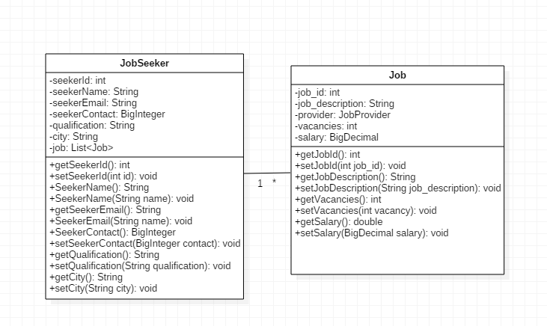
POJO CLASSES

Slide 4
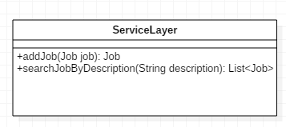
SERVICE LAYER

Slide 5
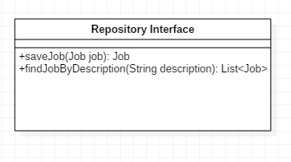
REPOSITORY LAYER

Slide 6
Thank You!!!

